Slide 1

Comprehensive Data Insights from the Olympics
Team members
Hrishitva Patel, Sreeja Yalamaddi, Aqdas Hussain, Anbumani Dhanapal

Slide 2

Data Source
Historical Olympics Data: https://www.kaggle.com/datasets/piterfm/olympic-games-medals-19862018
2024 Olympics Data:
https://www.kaggle.com/datasets/sajkazmi/paris-olympics-2024-games-dataset-updated-daily

Slide 3
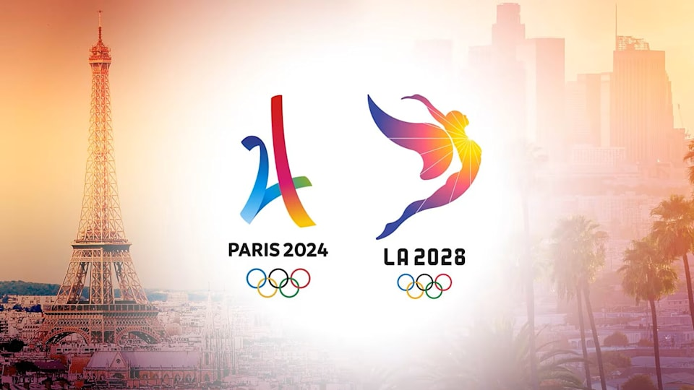
PROJECT BACKGROUND
Analyze historical Olympics data from 2000 to 2024 for critical insights
Provide meaningful predictions for 2028 Los Angeles Olympics

Slide 4
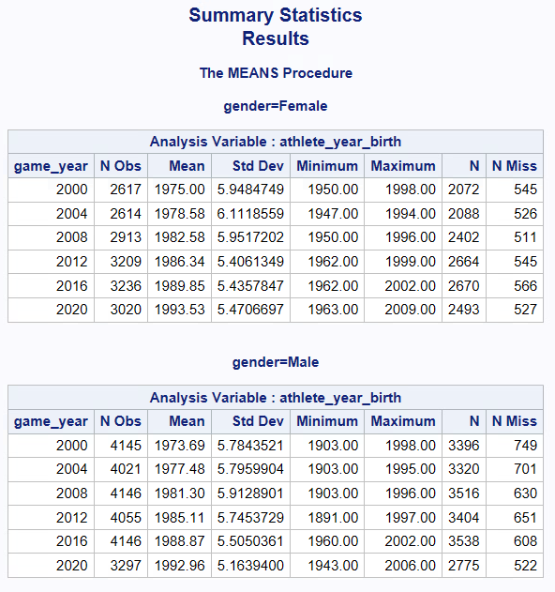

Data Inspection
Replaced the 0's with null value for ‘athlete_year_birth’ in combined table to prevent their inclusion in average calculations.

Slide 5
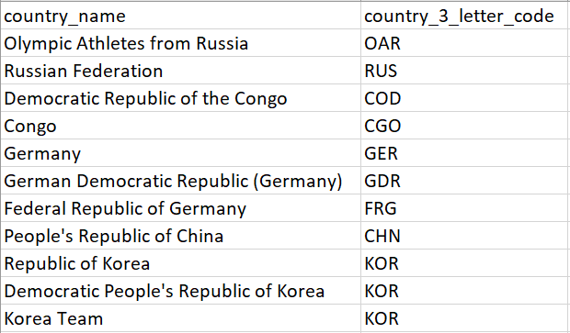
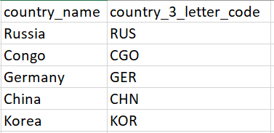


Data Cleaning
Considered only 2000 to 2024 data as our analysis range
Filtered only Summer Olympics due to the familiarity & medal count comparisons
Standardized country names across both datasets to ensure consistency

Slide 6
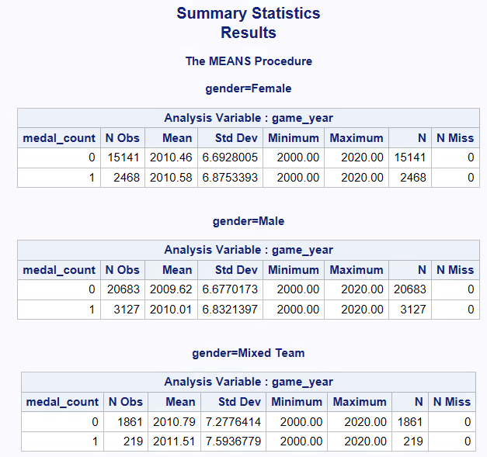
Data Verification
Summary Statistics for Considered Range, Gender Computation & medal points (Cleaned)

Slide 7
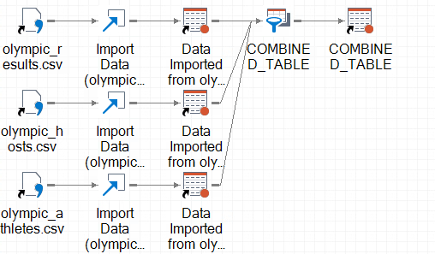
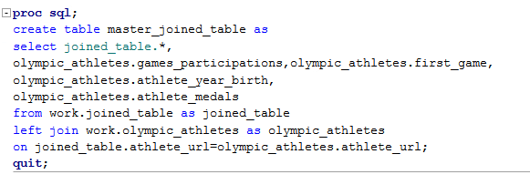
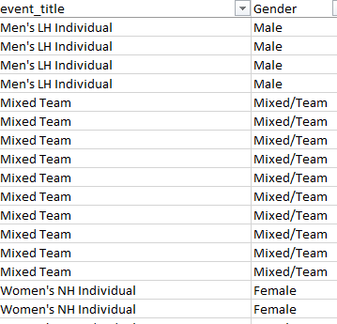
Merging Multiple Historical Olympic data with 2024 Dataset
Olympics Results, Athletes, Hosts dataset were merged to form the Combined Master Dataset using left join
Added Computed Columns for normalization & Gender-wise comparison
Added a column named Medal_count, Medal_Points to understand the weightage of medals as per Medal Tally (Gold =3, Silver = 2, Bronze =1)
Added ‘Gender’ based on Event_title

Slide 8


DATA ANALYSIS

Slide 9
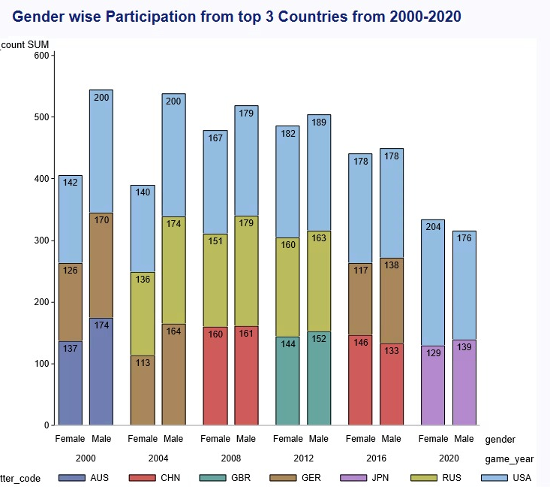
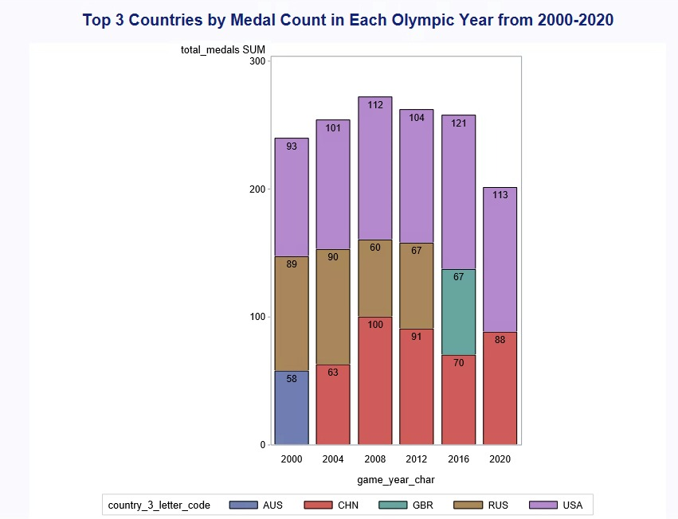
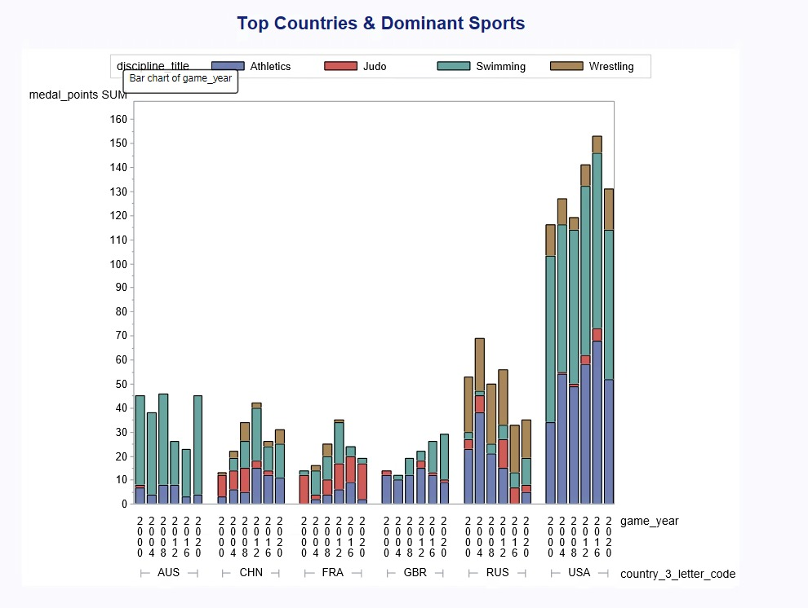

Analysis of Gender Disparity, Olympic Participation & Dominant Sports
Male participation consistently exceeds female participation across all years, reflecting a gender disparity. The USA has led participation for most years, followed by countries like China (CHN) and Russia (RUS). Participation peaked around 2008–2012 and declined in 2016 (Zika virus) & 2020 (covid)
The USA leads consistently, peaking at 121 medals in 2016. China and Russia excel in 2004 and 2008. Medal counts dropped in 2020, likely due to the pandemic.
The USA’s dominance reflects strong athletic programs, while China shows notable growth in key years
Uptrends → England (Swimming), France (Judo), Australia (Swimming)
Downtrends → France (Athletics), Russia (Athletics), England(Athletics)

Slide 10
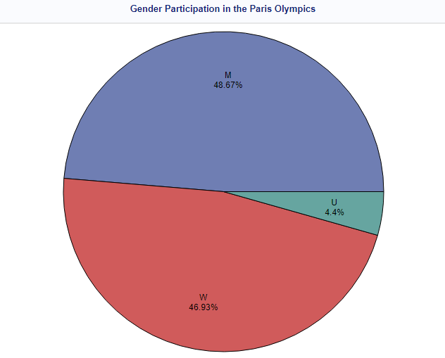
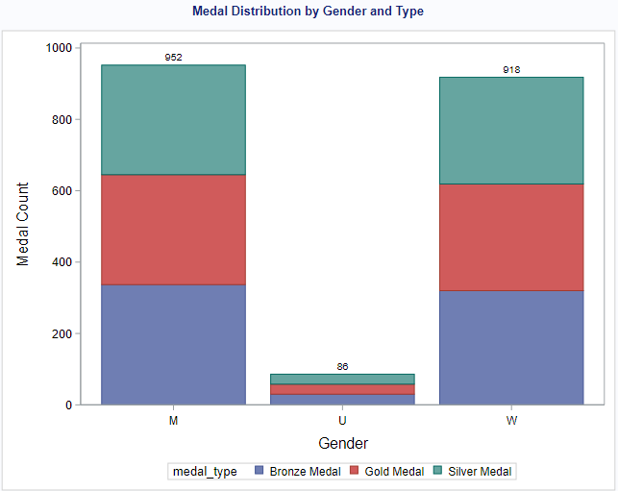
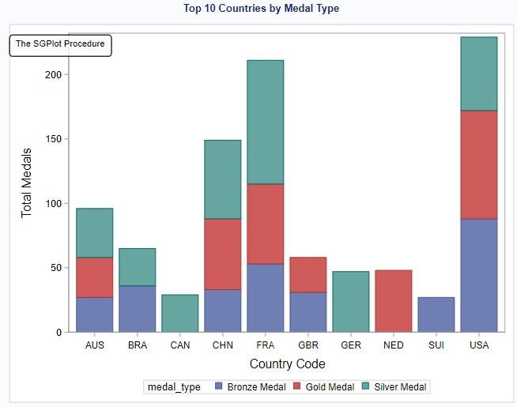
Analysis of Gender Disparity & Dominant Sports (2024 Deep Dive)
Almost equal % between gender, represents a good landmark in the fight against gender disparity in relation to sports.
The balance in the distribution of the medals puts a policy into practice in Esta's perspective, emphasizing that different genders now enjoy equal chances and similar training. However, undefined gender entries imply a data collection issue that needs to be addressed
•United States (USA): Leading in all medals and having won over 200 medals.
•France (FRA) and China (CHN): As anticipated, the ‘‘always high performers’’ comprise the nations consistently conveying high results on international tests.
•Australia (AUS): Showed consistency in the scores of all types of medals.
Insights: This can be associated with the fact that the sports infrastructure and athletes of the USA are systematically invested. Aspiring nations should learn and adopt excellent practices, which calls for research on the strategies used by developed countries.

Slide 11
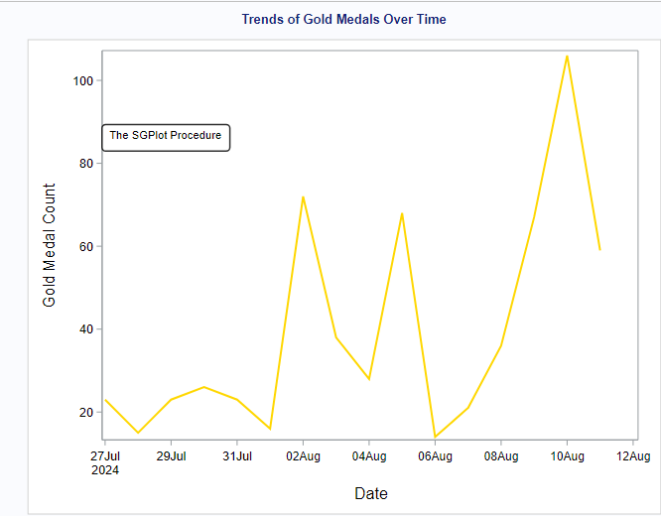
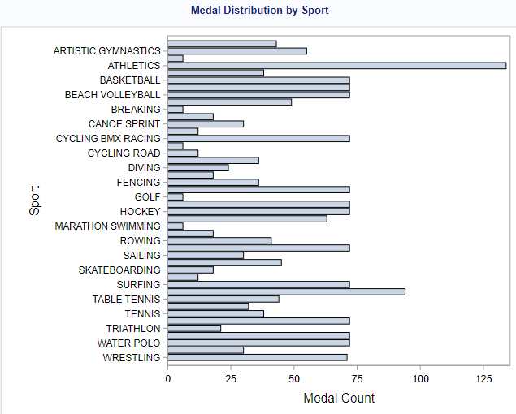
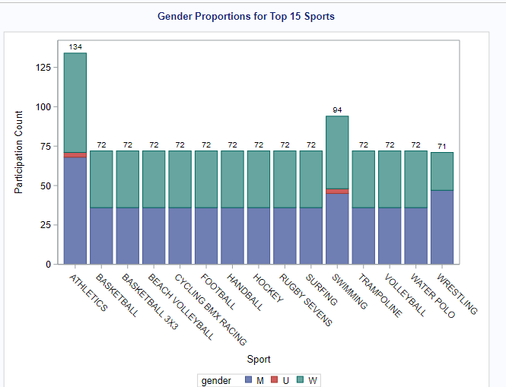
Analysis & Insights (2024 Deep Dive)
•Over 100 gold medals were awarded on these peak dates.
Insights: Exploiting events on specific days enhances global access, attention, and interest, indicating the essence of timing these events
Athletics’ dominance highlights its broad appeal and competitive diversity. Nations aiming to boost medal tallies should focus on expanding their presence in high-yield sports.
Male dominance: Wrestling, weightlifting.
Female dominance: Artistic gymnastics, synchronized swimming.
Balanced representation: Athletics, swimming.
Insights: These patterns highlight deeply rooted cultural and physiological trends. Targeted programs can address gender gaps in underrepresented disciplines

Slide 12
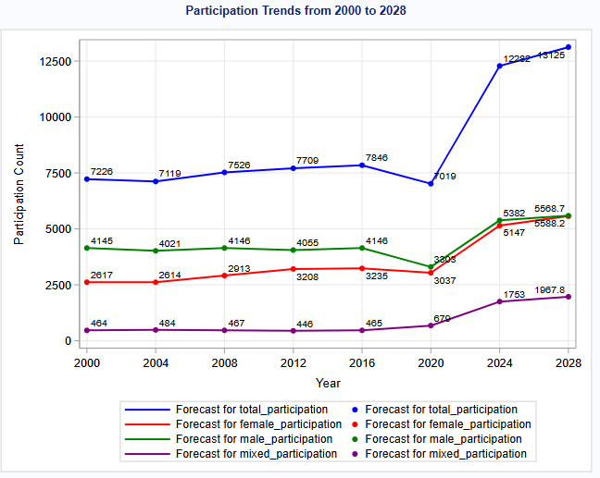
Key Predictions & Analysis for 2028 LA Olympics
Total Participation Growth: Projected 7% increase from 2024 to 2028
Gender Parity Progress: Female participation shows consistent growth, equaled parity with male participation by 2028. A milestone in fostering towards inclusion and diversity on the world stage
Male Participation Plateau: Male participation remains relatively stable until 2020.

Slide 13
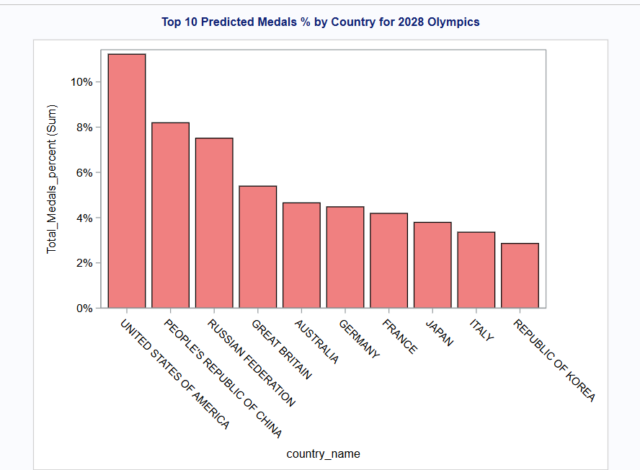
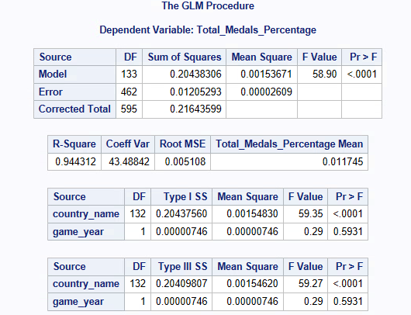
Top 10 Countries: Predicted Medal % Leaders
USA is projected to lead with 125–135 medals, benefiting from a host advantage (~16–17%)
Impact of Russia’s Ban : While Russia may still compete as Independents, countries like USA, China, Germany, Japan, and France, may gain significant advantage in disciplines such as gymnastics, wrestling, biathlon, and diving.

Slide 14
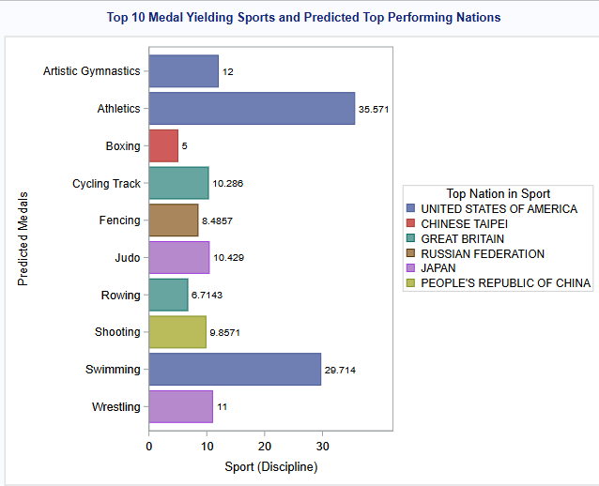
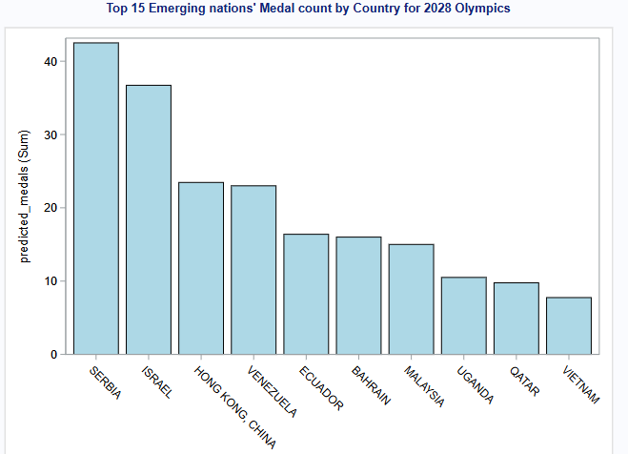
Top Medal Earners and Their Best Performers
Medal Forecast for Emerging Countries
USA may remain dominant in the most medal yielding sports – Athletics , Swimming as proven historically.
Countries like Italy, France, and Germany may take advantage of sports like Fencing where Russia got some edge in the past
Serbia: Expected Growth: Additional medals in tennis (e.g., Novak Djokovic) and water polo.
Hong Kong: Expected Growth: Boost in table tennis and badminton events.
Israel: : Judo and sailing medal opportunities.

Slide 15

Concluding Notes
Russia’s Absence opens up medal opportunities for countries to capitalize on historically strong Russian events, such as Fencing, Wrestling, and Gymnastics.
Emerging Nations can leverage new sports like Squash, Cricket, Flag Football, and Lacrosse to boost medal counts, driven by recent growth in these disciplines.
Increased Participation (up by 7%) and gender inclusivity (with more female and mixed-gender events) will shape a more diverse Olympic Games, contributing to progress toward gender parity.
Stable Male Participation: The plateau in male athletes emphasizes the growing significance of inclusive categories in future Olympic trends, encouraging a more diverse athlete pool.

Slide 16
Key Features of the Framework
Comprehensive Framework:
The framework is built to handle a broad range of complex queries, utilizing advanced statistical methods such as Generalized Linear Models (GLM) and Time-Series Analysis. These methods are applied to Olympics prediction, ensuring accurate and data-driven insights.
Customized Reports:
It generates tailored reports that simplify the extraction of complex insights for the analysis team. This customization enables easy interpretation of predictions, trends, and performance metrics, making it easier to communicate the analysis effectively.

Slide 17
Thank you!

Slide 18
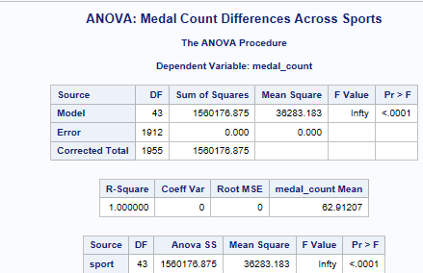
Additional Slides : Statistical Insights (2024 Olympics – ANOVA Analysis)
An ANOVA test analyzed medal counts across sports, revealing significant differences (p < 0.001). Key findings include:
•High medal counts in athletics and swimming.
•F-statistic: 36283.18, indicating substantial variation between sports.
Insights: Statistical evidence confirms athletics’ and swimming’s dominance, emphasizing the need for strategic investments in these disciplines.
An ANOVA test analyzed medal counts across sports, revealing significant differences (p < 0.001). Key findings include:
• High medal counts in athletics and swimming.
• F-statistic: 36283.18, indicating substantial variation between sports.
Insights: Statistical evidence confirms athletics’ and swimming’s dominance, emphasizing the need for strategic investments in these disciplines.
Notes:
Conclusion for 2024 Deep Dive
The analysis provided a comprehensive overview of Olympic medal data, uncovering significant trends and disparities. Key takeaways include:
1. Gender participation is nearly balanced, though disparities exist in certain sports.
2. The USA’s dominance underscores the importance of systematic sports development.
3. Athletics and swimming offer the highest medal yields, as validated by statistical analysis.
________________________________________
Recommendations
1. Focus on High-Yield Sports: Nations should prioritize athletics and swimming for medal optimization.
2. Address Gender Disparities: Expand inclusivity programs in gender-skewed sports.
3. Optimize Event Scheduling: Leverage peak dates for high-profile events to maximize engagement.

